Slide 1



Crop yield prediction in India
using machine learning
College Name:Arjun college of technology
Student names: C.Indra
P.Hemanth reddy
K.Madhu
K.Venkatesh

Slide 2
Problem Statement
Brief Overview:
Problem Statement: Using variables such crop type, soil quality, and weather (temperature, humidity, and rainfall), we seek to forecast agricultural yields in a given area. Farmers may boost agricultural output and lower losses by making well-informed decisions regarding planting, irrigation, and harvesting based on precise crop yield forecasts. The objective is to create a predictive model that can calculate the anticipated yield of various crops under a range of environmental circumstances.
Key Objectives:
The key objectives of crop yield prediction are to analyze factors like weather, soil, and farming practices, collect relevant data, build a predictive model, and help farmers make better decisions to increase crop yields and reduce losses.
Source :
www.freepik.com/

Slide 3
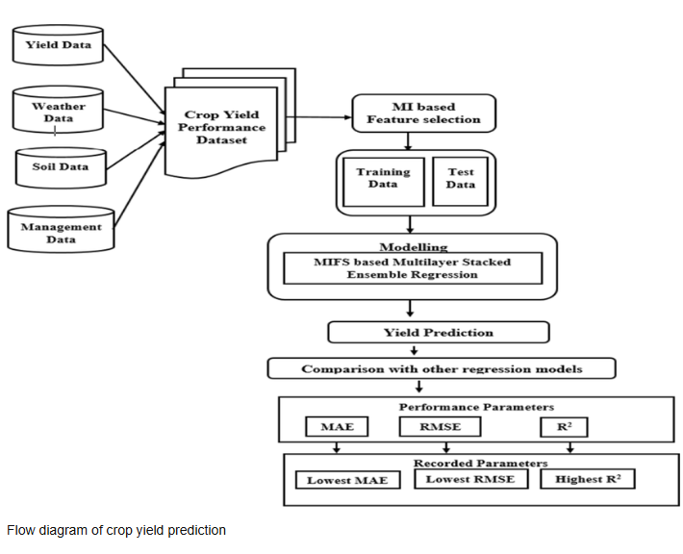
Solution
Collect Data: Gather weather, soil, and crop information to understand how these factors affect growth.
Use Technology: Use machine learning or simple algorithms to make predictions based on collected data (like past weather and soil conditions).
Satellite and Drone Images: Use satellites and drones to track crop health and predict yields by observing the plants from above.
Weather Forecasting: Check weather forecasts to know how future weather will impact crops, helping plan planting and harvesting times.
Smart Farming Tools: Use sensors in the field to measure soil moisture, temperature, and nutrients to help predict crop health.
Farmer Apps: Provide farmers with apps that give advice on when to plant, water, and harvest based on predictions.
These solutions can help farmers grow more crops and make better decisions!
Source :
www.freepik.com/

Slide 4
Dataset Overview
Dataset Description:
We use dataset related to crop yield prediction from github and it contains several features like state ,district_name,crop year, crop name,production,season , area..
Source :
www.freepik.com/

Slide 5
Methodology
Approach:
1.Collect Information:Gather data like weather, soil quality, and types of crops to understand what affects their growth.
2. Look for Patterns:Analyze the data to find patterns in how things like temperature and soil moisture affect how much crops grow.
3. Create a Prediction Model:Build a system (like a computer program) to predict how much crops will grow based on the patterns found in the data.
4. Test and Improve the Model:Check if the system works well by testing it with new data, and make it better if needed.
5. Make Predictions:Use the model to predict how much crops will grow in the future, based on current conditions.
6. Help Farmers:Share these predictions with farmers to help them make better choices about planting, watering, and harvesting crops.
These steps help farmers plan better and grow more crops with less waste!
Algorithms used:
Linear regression,random forest,support vector regression,decision tree,cross validation
Source :
www.freepik.com/

Slide 6
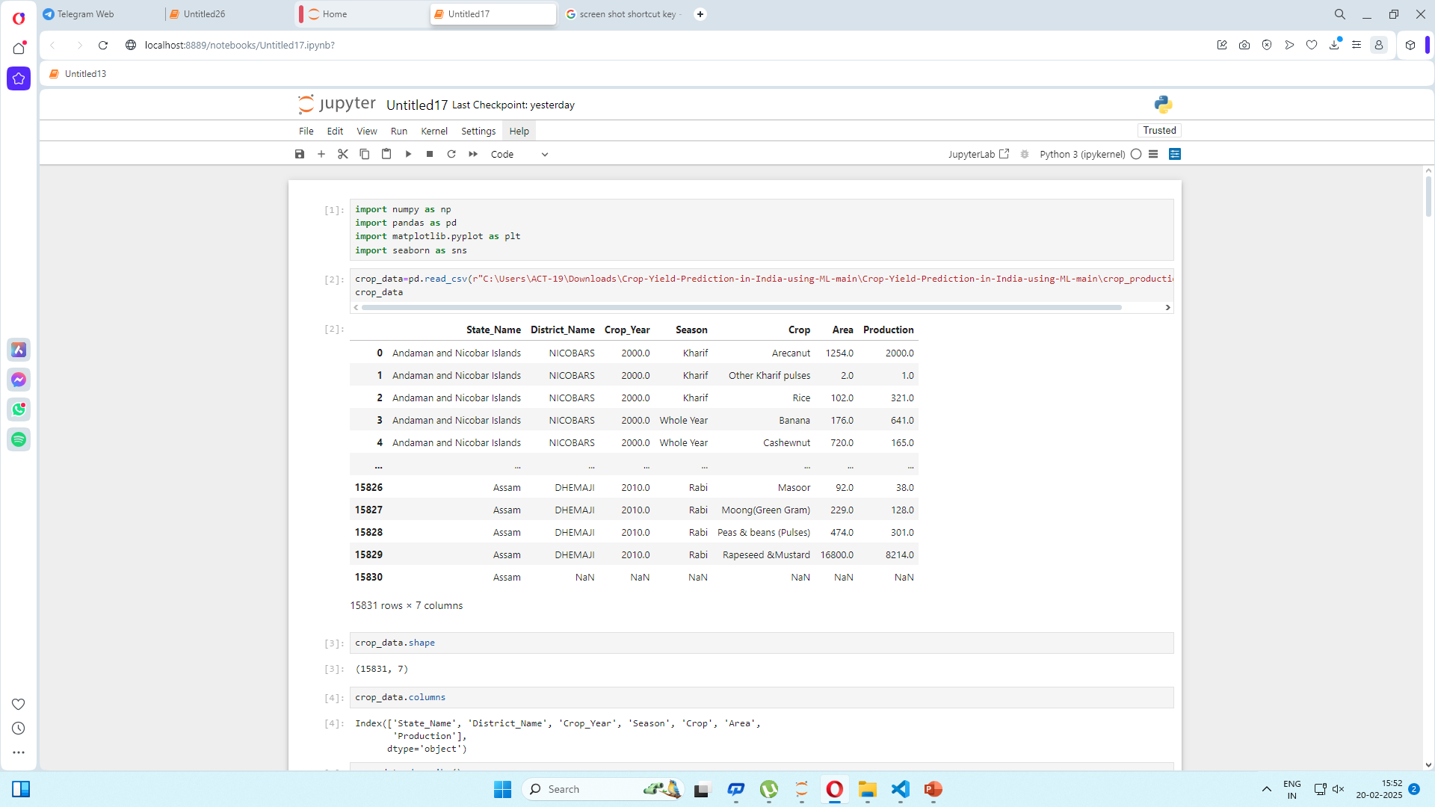
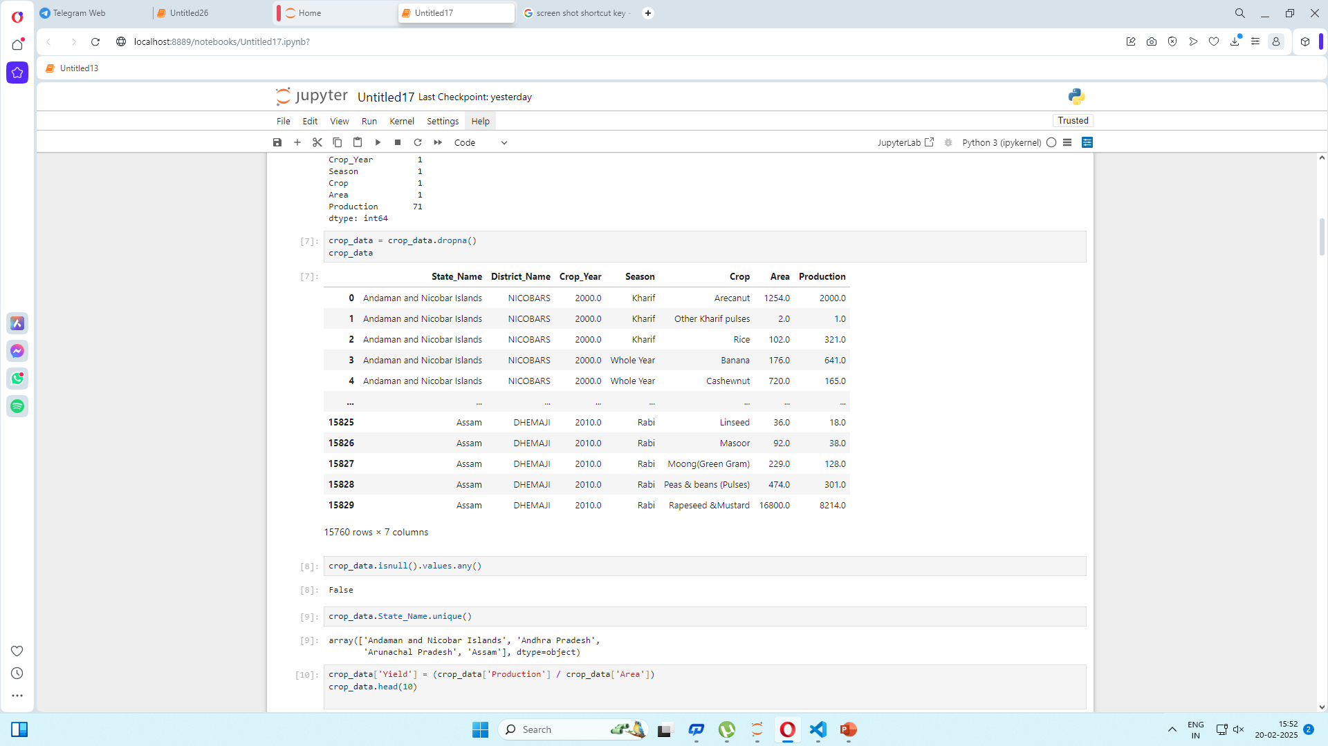
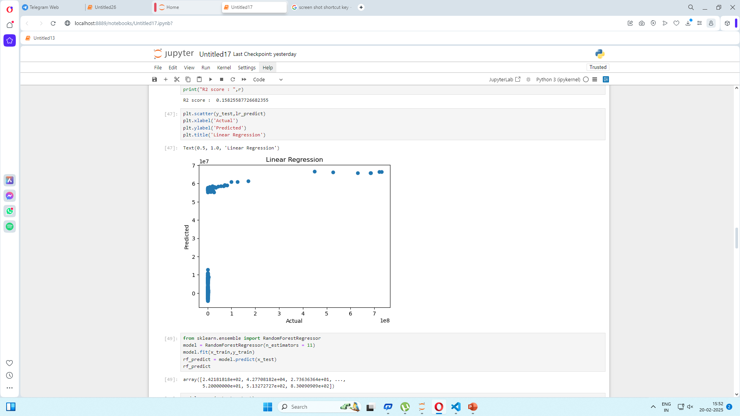
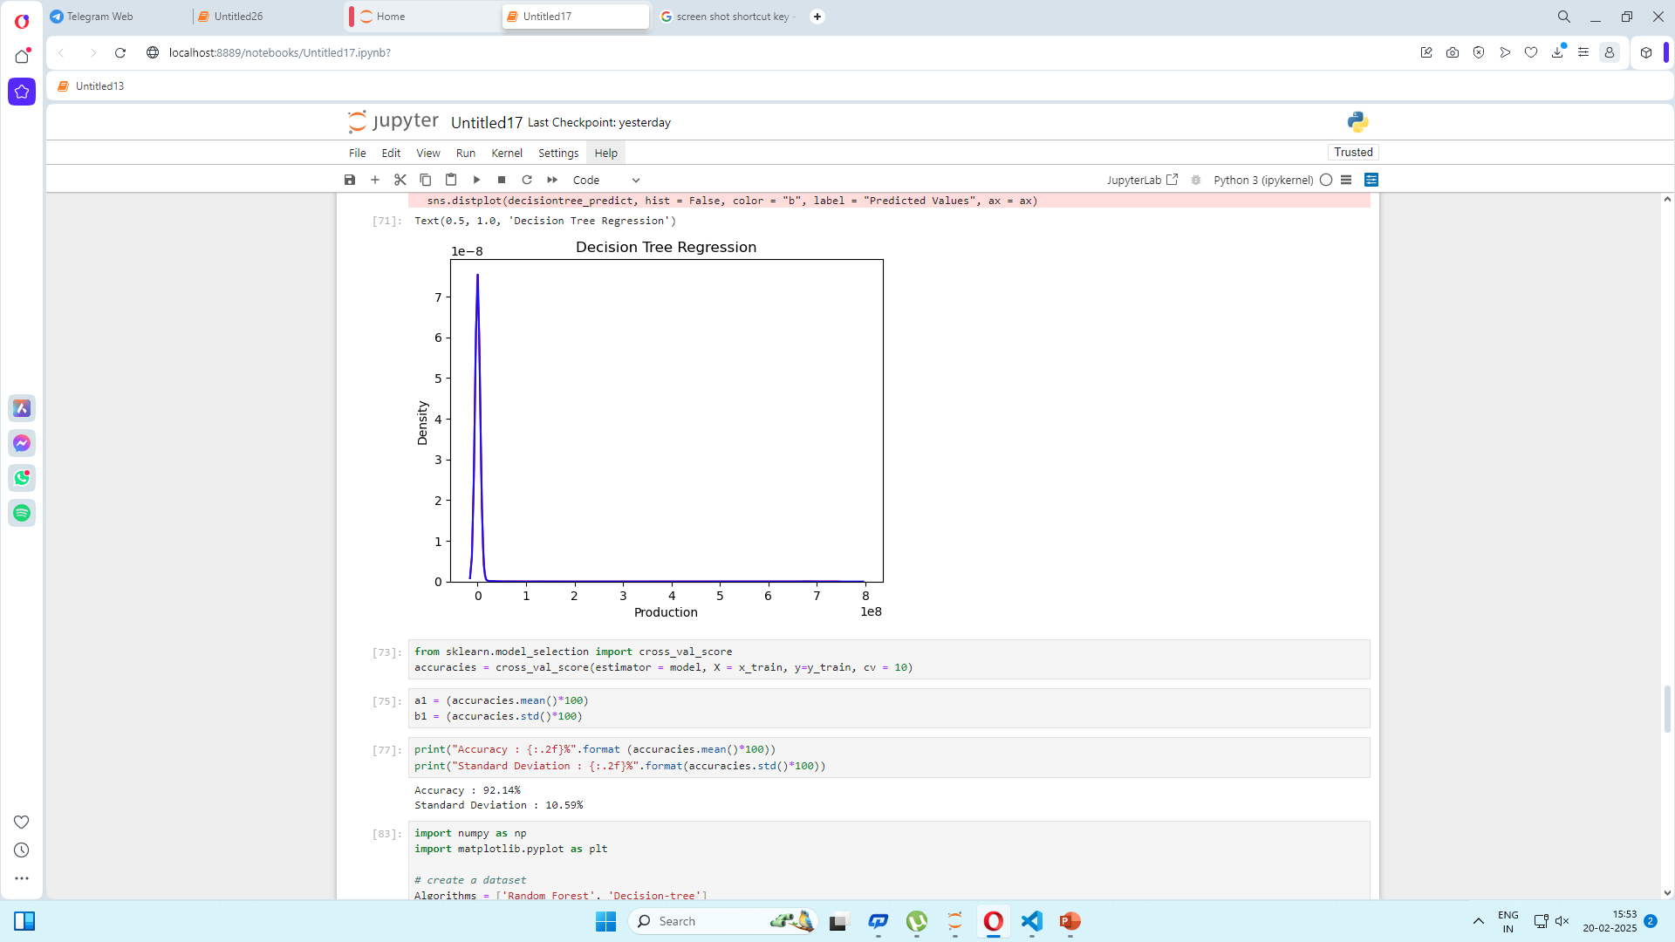
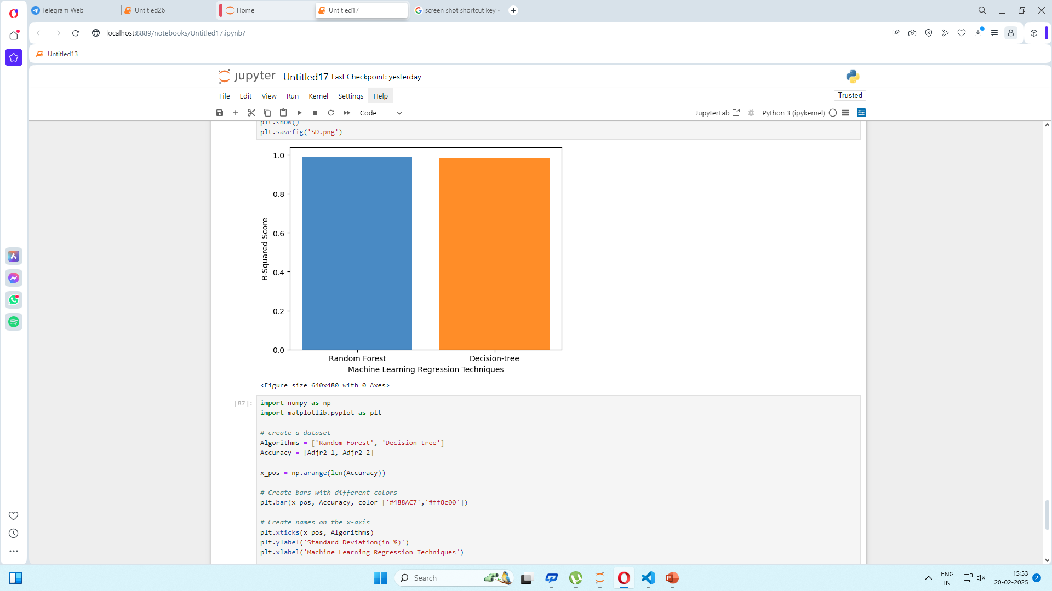
Results
Source :
www.freepik.com/

Slide 7

Conclusion
Summary:
In this case study, the goal was to predict crop yields to help farmers make better decisions. Here's a quick summary of the solution:
Data Collection: We gathered information like weather, soil quality, and crop types.
Analysis: We looked for patterns in the data to see how different factors affect crop growth.
Prediction Model: We created a system that predicts crop yield based on the patterns we found.
Testing and Improvement: We tested and improved the model to make sure it’s accurate.
Prediction Use: The model helps predict future crop yields, guiding farmers on when to plant, water, and harvest.
Farmer Support: Farmers get advice from these predictions to make smarter farming decisions.
Effectiveness:
This solution is effective because it helps farmers plan better, reduce waste, and grow more crops with less risk. By using data and technology, farmers can make informed choices that lead to higher productivity and more efficient farming.
Future Work: For future improvements, collect more data from different regions and include factors like pests and diseases. Use real-time data from sensors to make predictions more accurate. Improve tools for farmers to easily use the predictions. Test the model in various climates to ensure it works well everywhere.
Source :
www.freepik.com/

Slide 8
References
https://github.com/ankitaS11/Crop-Yield-Prediction-in-India-using-ML

Slide 9
Thank You
Notes:
Thank You !!

